Slide 1
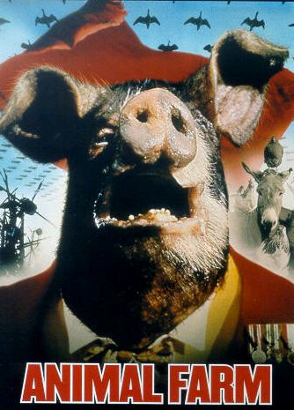
Animal Farm
By George Orwell

Slide 2
Allegory

Slide 3
Allegory
An allegory is a story, poem, or picture that can be interpreted to reveal a hidden meaning, typically a moral or political one.

Slide 4
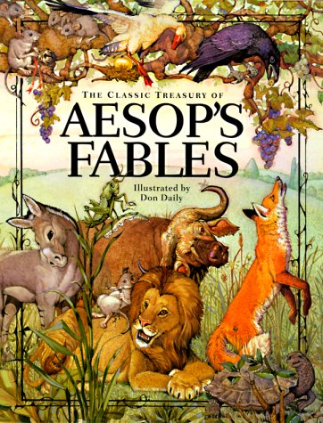
Examples of Allegory
Aesop's Fables.
Most likely the first allegorical work that most people read. Credited to Aesop who lived in ancient Greece, it is a collection of short stories like The Fox and the Grapes, The Tortoise and the Hare, and The Ant and the Grasshopper that became a source of moral messages. Aesop used animals and their actions to allegorically represent human beings and our way of living.

Slide 5
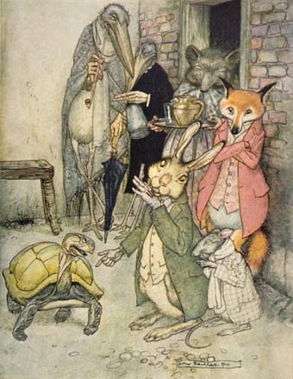
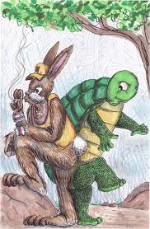
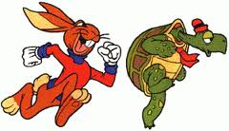
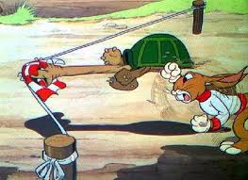
The Tortoise and the Hare

Slide 6
The Tortoise and the Hare
Once upon a time there was a hare who, boasting how he could run faster than anyone else, was forever teasing tortoise for its slowness. Then one day, the irate tortoise answered back: “Who do you think you are? There’s no denying you’re swift, but even you can be beaten!” The hare squealed with laughter.
“Beaten in a race? By whom? Not you, surely! I bet there’s nobody in the world that can win against me, I’m so speedy. Now, why don’t you try?” Annoyed by such bragging, the tortoise accepted the challenge. A course was planned, and the next day at dawn they stood at the starting line. The hare yawned sleepily as the meek tortoise trudged slowly off. When the hare saw how painfully slow his rival was, he decided, half asleep on his feet, to have a quick nap.
“Take your time!” he said. “I’ll have forty winks and catch up with you in a minute.”

Slide 7
The Tortoise and the Hare
The hare woke with a start from a fitful sleep and gazed round, looking for the tortoise. But the creature was only a short distance away, having barely covered a third of the course. Breathing a sigh of relief, the hare decided he might as well have breakfast too, and off he went to munch some cabbages he had noticed in a nearby field. But the heavy meal and the hot sun made his eyelids droop. With a careless glance at the tortoise, now halfway along the course, he decided to have another snooze before flashing past the winning post. And smiling at the thought of the look on the tortoise’s face when it saw the hare speed by, he fell fast asleep and was soon snoring happily.

Slide 8
The sun started to sink, below the horizon, and the tortoise, who had been plodding towards the winning post since morning, was scarcely a yard from the finish. At that very point, the hare woke with a jolt. He could see the tortoise a speck in the distance and away he dashed. He leapt and bounded at a great rate, his tongue lolling, and gasping for breath. Just a little more and he’d be first at the finish. But the hare’s last leap was just too late, for the tortoise had beaten him to the winning post. Poor hare! Tired and in disgrace, he slumped down beside the tortoise who was silently smiling at him.“ Slowly does it every time!” he said.

Slide 9
How is this an allegory?
What is this story trying to represent?
What lesson are they teaching us?

Slide 10
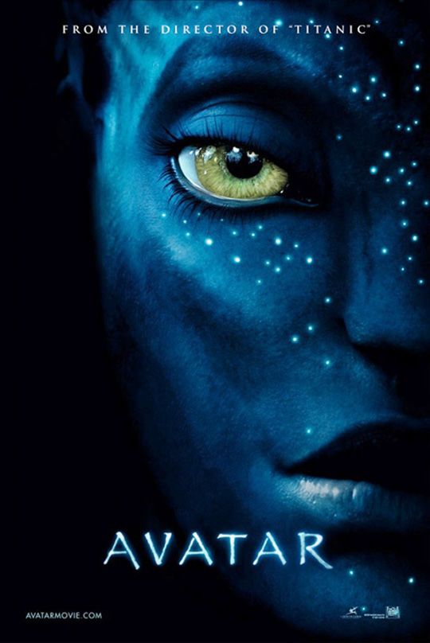
Examples of Allegory
"There are obvious layers of allegory [in the movie Avatar]. The Pandora woods is a lot like the Amazon rainforest (the movie stops in its tracks for a heavy ecological speech or two), and the attempt to get the Na'vi to 'cooperate' carries overtones of the U.S. involvement in Iraq and Afghanistan." (Owen Gleiberman, review of Avatar. Entertainment Weekly, Dec. 30, 2009)

Slide 11
Allegory in The Wizard of Oz
Allegory for the economics and politics of the 1890s
Dorothy
Scarecrow, Tinman, Lion
Emerald City
Colors used throughout Oz (green, gold, silver)

Slide 12
How could this film be considered an allegory?

Slide 13
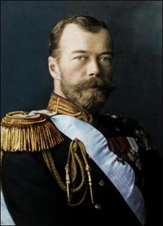
Link to Russian Revolution
Czar Nicholas
A poor leader at best, compared to western kings
Cruel, sometimes brutal with opponents
Sometimes kind – hired students as spies

Slide 14
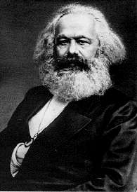
Karl Marx
Invented communism
“workers of the world unite”,
Take over government
Dies before revolution

Slide 15
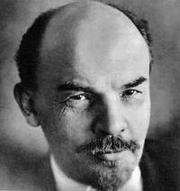
Vladimir Lenin
Old Major, represents both Marx and Lenin, serves as the source of the ideals that the animals continue to uphold even after their pig leaders have betrayed them.

Slide 16
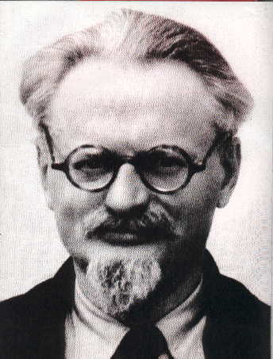
Leon Trotsky
Other leader of “October Revolutions”
Pure communist, followed Marx
Wanted to improve life for all in Russia
Chased away by KGB (Secret police)

Slide 17
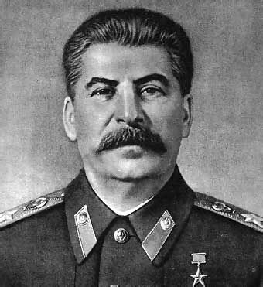
Joseph Stalin
Not a great speaker, not educated like
Trotsky
Same as Napoleon, didn’t follow
Marx’s ideas
Cared for power, killed all that
Opposed him.

Slide 18
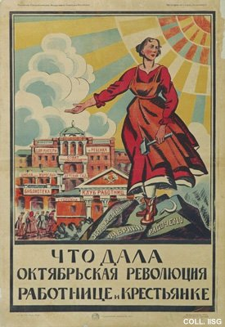
Propaganda
What the revolution has done for the peasant woman.
Library

Slide 19
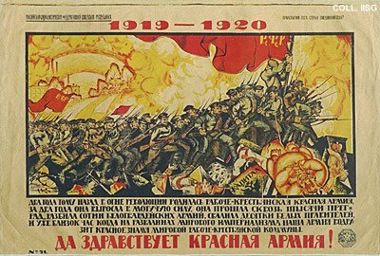
Long Live the Red Army!

Slide 20
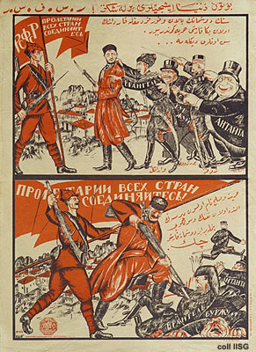
Your enemies want you to fight against your brother

Slide 21
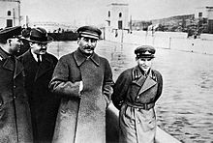
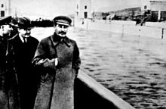
Controlling Images
Nikolai Yezhov, walking with Stalin in the top photo from the 1930s, was killed in 1940. Following his execution, Yezhov was edited out of the photo by Soviet censors.[36] Such retouching was a common occurrence during Stalin's rule

Slide 22
Powerful Songs
Alma Mater Hail to thee, O Clayton Valley With our colors - red, white and blue! Hail to thee, O noble eagles, Soaring high, with honor true! Future build with faith and loyalty Strength and spirit shall prevail. Clayton Valley! Clayton Valley! To thee our hearts shall sing, All Hail!

Slide 23
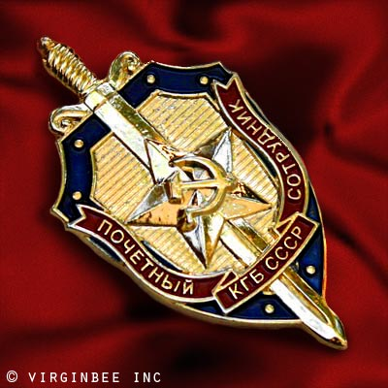
KGB – Secret Police
Not really police, but forced support for Stalin
Used force, often killed entire families for
Disobedience.
Totally Loyal, part of Lenin’s power, even over
Army.

Slide 24
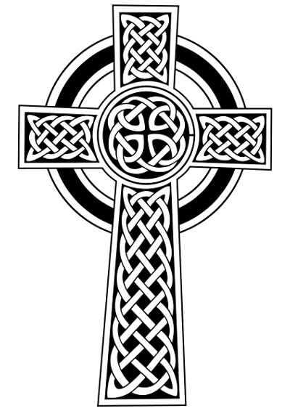
Religion
Marx said it was, “Opiate of the people”
Lie used to make people not complain and
Do their work
Stalin believed religion would stop violent
Revolutions.

Slide 25
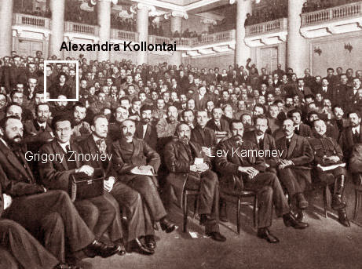
Vain, Selfish Russians

Slide 26
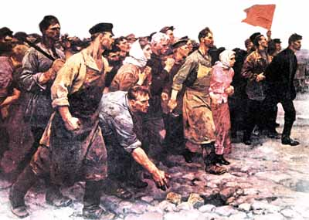
Dedicated, but tricked Communist Supporters

Slide 27
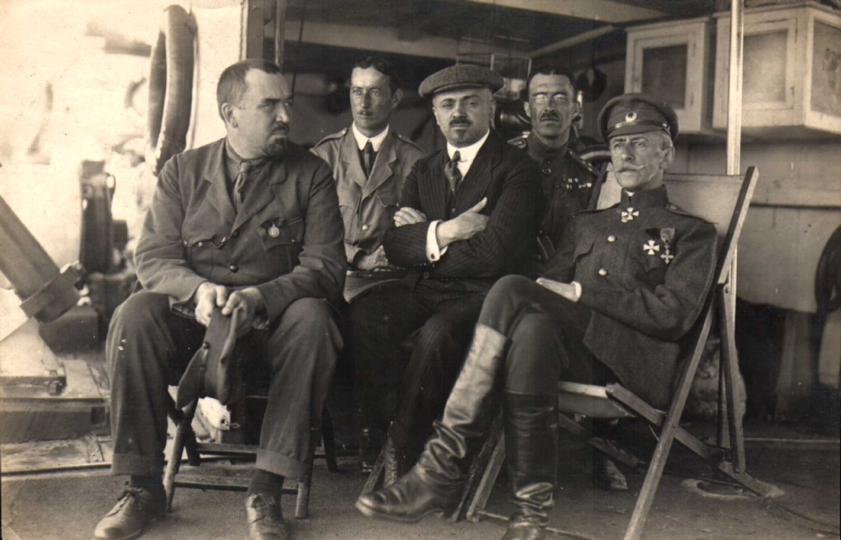
Skeptical Russians

Slide 28
Non Participating Intellectuals

Slide 29
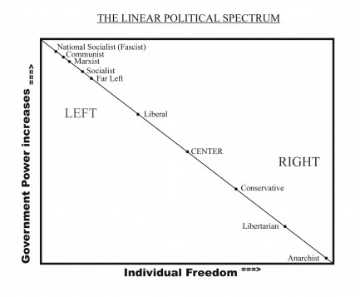

Slide 30
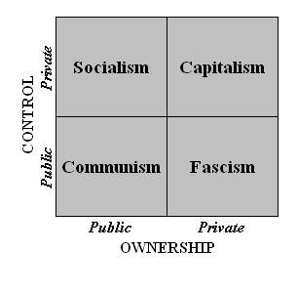

Slide 31
Brainstorm
Who do the neighbors to Animal Farm Represent?

Slide 32
Further Links through Characters
Mrs. Jones - She represents the Tsar's wife, Alexandra.
Mr. Pilkington - Owner of Foxwood (Leader of England). He doesn't represent one person in particular, but rather is a composite of all of the leaders of England
.Mr. Frederick - Owner of Pinchfield (Leader of Germany). Frederick is a composite of the leaders of Germany. However, throughout most of the book, Frederick is a representation of Hitler. It is said that Frederick had ''flogged an old horse to death (A reference to Hitler's euthanasia program), he had killed a dog by throwing it into the furnace (Most likely a reference to Night of Knives), and that he amused himself in the evenings by making cocks fight with splinters of razor-blade tied to their spurs.’
'Mr. Whymper - A solicitor living in Willingdon. Acted as an intermediary between Animal Farm and the outside world in matters of trade. Represents capitalist who did business with the Soviet state.

Slide 33
Links Through Actions
In the book, Old major's skull is displayed in a similar manner to the way Lenin's remains were displayed to the public
The Farmhouse - (The Kremlin.) Home of Mr. Jones (the Czar). After the revolution, there were some that wanted to destroy the farmhouse, but it was decided to preserve it as a museum. (The Kremlin was saved in a similar manner). Eventually, Napoleon (Stalin) decided to take up residence there.

Slide 34
Links Through Setting
Manor Farm - Russia.
Foxwood - Foxwood represents England. The novel describes it as "a large, neglected, old-fashioned farm, much overgrown by woodland, with all its pastures worn out and its hedges in a disgraceful condition. Its owner, Mr. Pilkington, was an easy-going gentleman farmer who spent most of his time in fishing or hunting according to the season.”
Pinchfiled – Pinchfield represents Germany. Orwell described it as "The other farm, which was called Pinchfield, was smaller and better kept. Its owner was a Mr. Frederick, a tough, shrewd man, perpetually involved in lawsuits and with a name for driving hard bargains.”
Willingdon - All of the farms mentioned in the book are located in the city of Willingdon, which is a metaphor for Europe. England - Since farms represent the various nations, England is a representation of the entire world.

Slide 35
Boxer, Clover
Proletariat – stupid, loyal working class people of Russian

Slide 36
Mollie
White Russians – Noble class, looked towards western ideas of democracy.

Slide 37
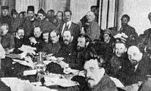
The Pigs
Bolsheviks, Reds, activists
People who believe in the cause.

Slide 38
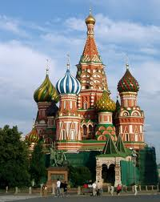
Moses
Russian Orthodox Church
Evangelists
people who need hope / faith
in something to get them through
bad times.

